Slide 1
ANT+
Mihir Shah

Slide 2
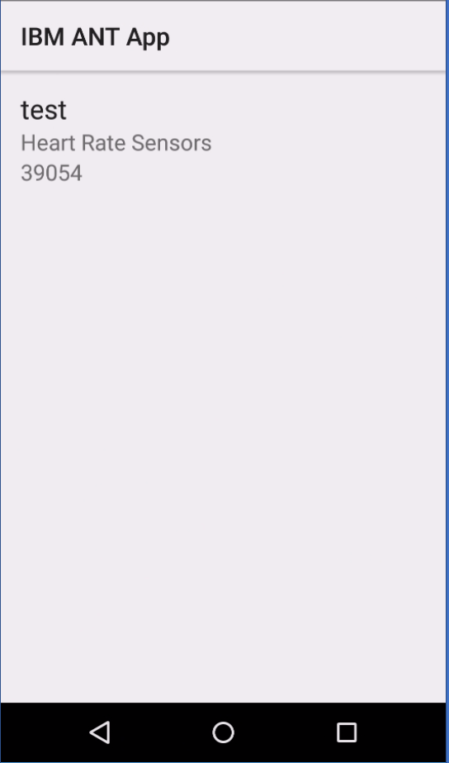
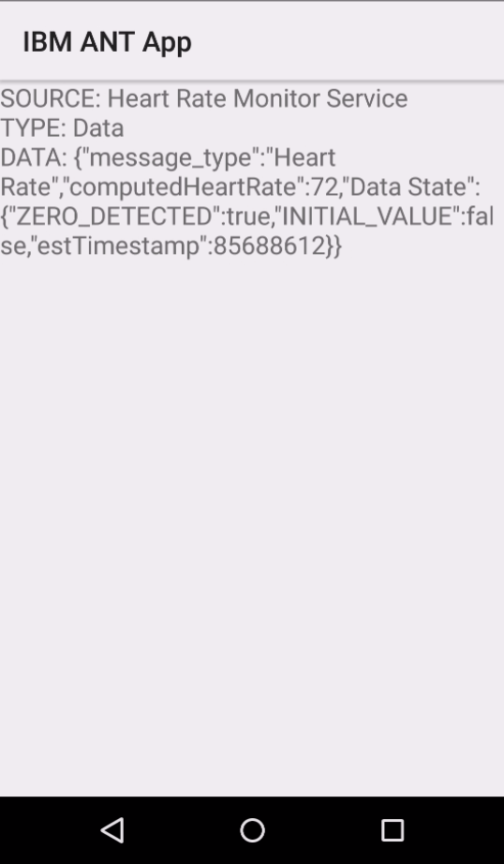
Start MQTT Service on App Start
MQTT Service
HeartRateMonitor Service
Selected
Devices
BikePower Service
Start Required services
Send device specifics to connect to
BikeCadence Service
Main Activity
Show Value Activity
Searches for devices
Lists the devices
User selects a device (should be able to select multiple)
User Selection goes to Show Value Activity
Based on user selection, starts the appropriate ANT services in the app.
Starts MQTT Service – connects to IOTF
Gets the device specifics from MainActivity
Subscribes to broadcasts from the services
Shows the broadcasts on the screen
MQTT Service
Connects to MQTT Broker
Subscribes to broadcasts from other services
Publishes data to MQTT Broker
HeartRateMonitor, BikePower, etc Service
Connects to the ANT device – details provided by the startService intent.
Subscribes to the events from ANT device
Broadcasts the data received from the events of ANT device

Slide 3
ToDos:
Short Term:
UI Update
Sometimes "ADAPTER_NOT_DETECTED" error shows up on Nexus 5, user might have to restart the app. Check with other devices.
Get rid of the Options Menu
Provide a check-box for each device in the listview to enable selection of multiple devices (One of each type, extension in long-term todos).
Add location information in transmission packet
If MQTT Publish failed, store the message to retry.
Long Term:
Extend the services to be able to connect to multiple devices. Example – heart rate monitor should be able to connect to multiple heart rate monitors

Slide 4
Heart Rate Data
1. Heart Rate Data - TRANSMITTED
1.1. computedHeartRate
1.2. Data State
1.2.1. ZERO_DETECTED
1.2.2. INITIAL_VALUE
1.3. estTimestamp
2. Page 4 Additional Data - NOT TRANSMITTED
2.1. manufacturerSpecificByte
2.2. previousHeartBeatEventTime
2.3. estTimestamp
3. Cumilative Operating Time - NOT TRANSMITTED
3.1. cumulativeOperatingTime
3.2. estTimestamp
4. Manufacturer and Serial - NOT TRANSMITTED
4.1. manufacturerID
4.2. serialNumber
5. VersionAndModel - NOT TRANSMITTED
5.1. hardwareVersion
5.2. softwareVersion
5.3. modelNumber
5.4. estTimestamp
6. Calculated RR Interval - TRANSMITTED
6.1. rrInterval
6.2. Data State
6.2.1. DATA_SOURCE_CACHED
6.2.2. DATA_SOURCE_PAGE_4
6.3. estTimestamp
7. RSSI Event - NOT TRANSMITTED
7.1. rssi - dBm
7.2.estTimestamp
8. Device State - TRANSMITTED
8.1. state - newDeviceState

Slide 5
Heart Rate Data Format
{
"source": "Heart Rate Monitor Service",
"type": "State",
"state": <Device State>
}
{
"source": "Heart Rate Monitor Service",
"type": "Data",
"data": {
"rrInterval": <int>,
"message_type": "RR Interval"
"Data State": {
"DATA_SOURCE_CACHED": <boolean>,
"DATA_SOURCE_PAGE_4": <boolean>
"estTimestamp": <int>
}
},
timestamp: <Unix timestamp>
}
{
"source": "Heart Rate Monitor Service",
"type": "Data",
"data": {
"computedHeartRate": <int>,
"message_type": "Heart Rate"
"Data State": {
"ZERO_DETECTED": <boolean>,
"INITIAL_VALUE": <boolean>
"estTimestamp": <int>
}
},
timestamp: <Unix timestamp>
}

